Slide 1
UNIT 3 ENTERPRISE MANAGEMENT SYSTEM
Total Hour:8hrs
Presented by
Er.Harendra Bikram Shah
Lecturer
Department of BE Computer

Slide 2
OUTLINES
3.1. Enterprise management system (EMS)
3.2. Enterprise Software: ERP/SCM/CRM
3.3. Information Management and Technology of Enterprise Software
3.4. Role of IS and IT in Enterprise Management
3.5. Enterprise Engineering, Electronic organism, Loose integration vs full Integration, Process alignment, Frame work to manage integrated change, future trends

Slide 3
ENTERPRISE MANAGEMENT SYSTEM (EMS)
Enterprise – an entire company, everything, all-inclusive
Management – The monitoring and controlling of entities
Systems – Information Technology Infrastructure, hardware and software, data, information, and processes
EMS is concerned with control, monitoring and the management of IT infrastructure and applications in order to optimize IT service delivery in Company.
COMPONENTS OF EMS
CAD/CAM/CAE [Computer Aided Design/Computer Aided Manufacturing Computer Aided Engineering System)
AMS (Attendance Management System)
DMS (Document Management System)
CMS (Communication Management System)
SMS (Security Management System)
HR (Human Resource)
IMS (Inventory Management System)
FM (Financial Management)

Slide 4
FOUR MAJOR COMPONENTS OF EMS
ERP (Enterprise Resource Planning)
CRM (Customer Relationship Management)
SCM (Supply Chain Management)
BI (Business Intelligence)
NEED OF EMS
Centralized Data Management:
Streamlined Processes:
Improved Decision Making:
Enhanced Collaboration:
Compliance and Risk Management:
Scalability and Adaptability:
Customer Relationship Management (CRM):
Cost Efficiency:

Slide 5
ENTERPRISE SOFTWARE: ERP/SCM/CRM
Enterprise software, also known as enterprise application software (EAS), is computer software used to satisfy the needs of an organization rather than individual users.
Enterprise software is an integral part of a CBIS (Computer Based Information System); a collection of such software is called an enterprise system.
A CBIS is an organized integration of hardware and software technologies and human elements designed to produce timely, integrated, accurate and useful information for decision making purposes

Slide 6
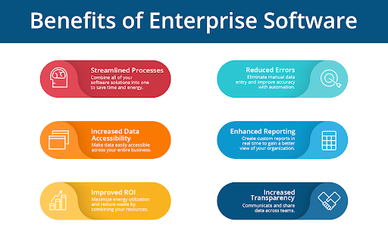

Slide 7
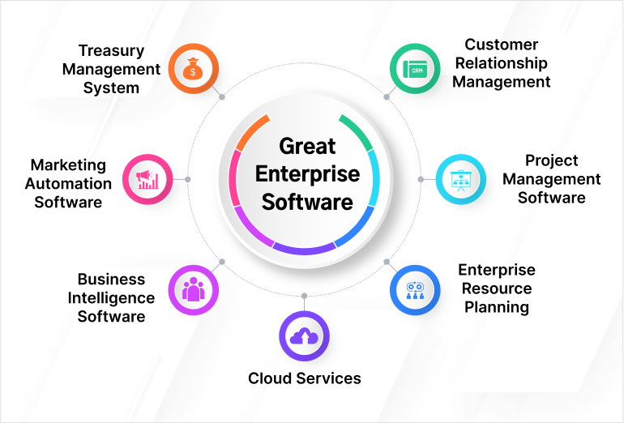

Slide 8
TYPES OF ENTERPRISE SYSTEMS
ERP - Enterprise Resource Planning
ERP is to improve and streamline internal business processes.
CRM - Customer Relationship Management.
CRM attempts to enhance the relationship with customers.
SCM - Supply Chain Management
facilitate the collaboration between the organization, its suppliers, the manufacturers, the distributors and the partners.

Slide 9
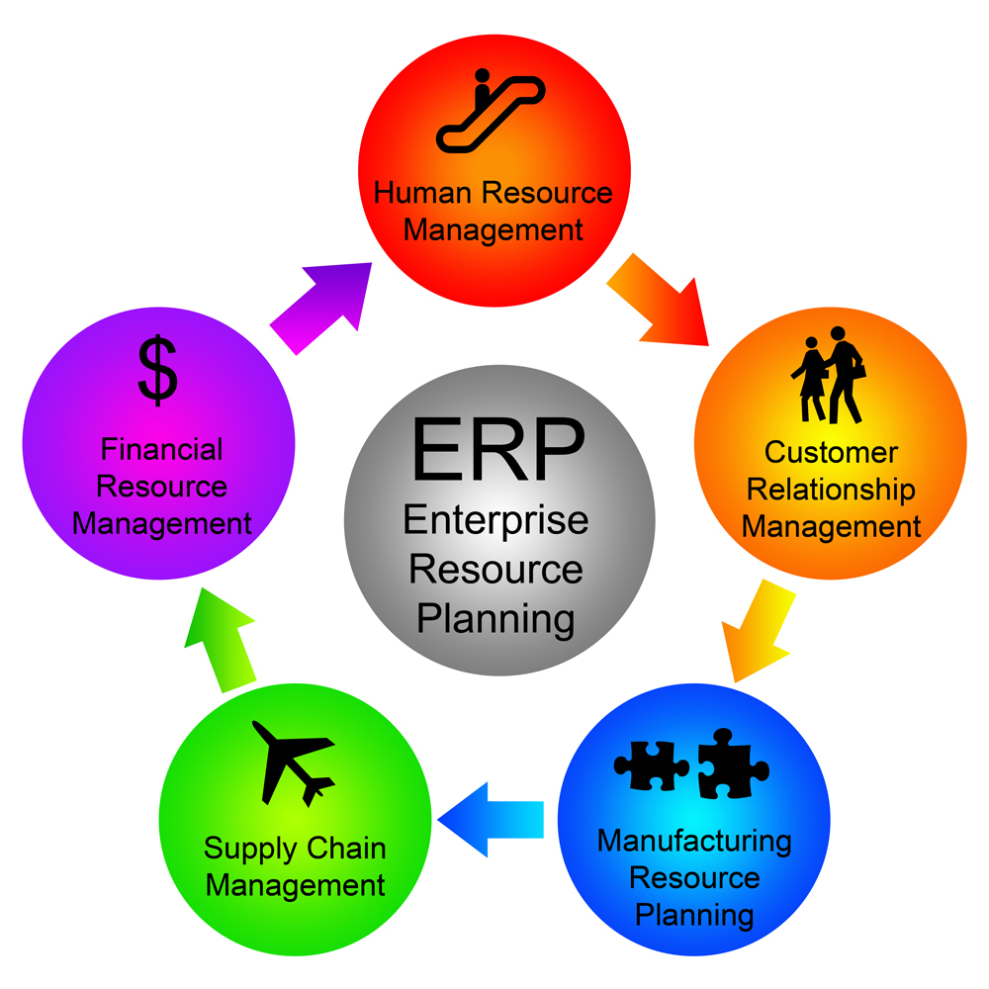
ERP - ENTERPRISE RESOURCE PLANNING
ERP software can integrate all of the processes needed to run a company.
refers to a type of software that organizations use to manage day-to-day business activities
such as accounting, procurement, project management, risk Management and compliance, and supply chain operations.
COMPONENTS OF ENTERPRISE RESOURCE PLANNING

Slide 10
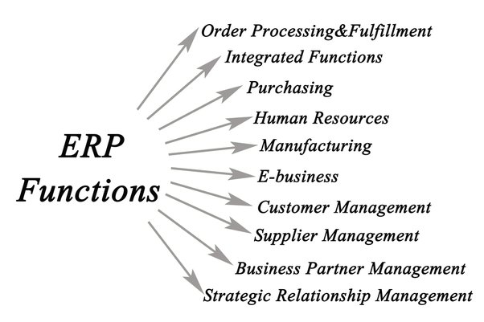
FUNCTION OF ENTERPRISE RESOURCE PLANNING

Slide 11
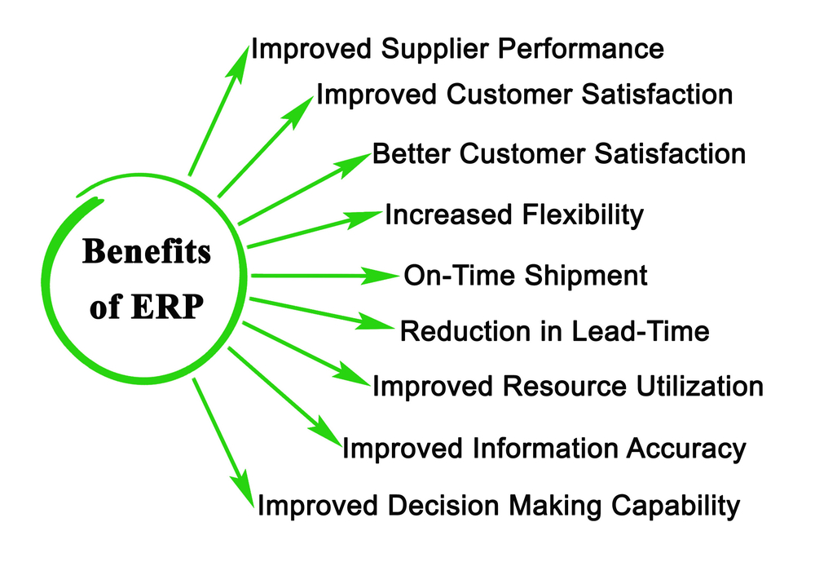
BENEFITS OF ENTERPRISE RESOURCE PLANNING

Slide 12
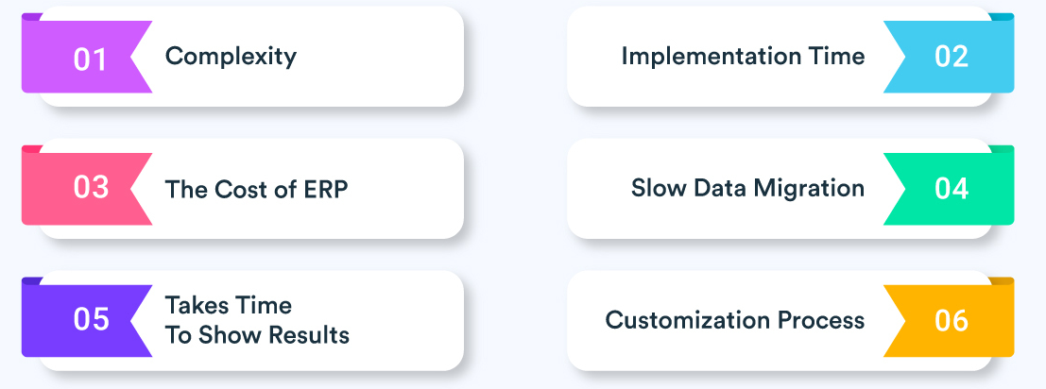
DISADVANTAGES OF ENTERPRISE RESOURCE PLANNING

Slide 13
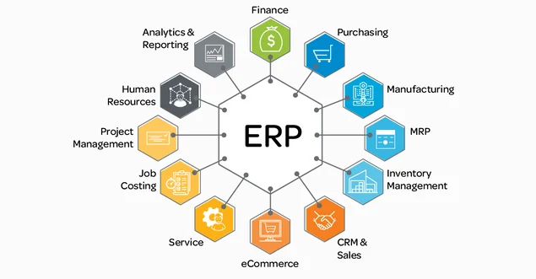
APPLICATIONS OF ENTERPRISE RESOURCE PLANNING

Slide 14
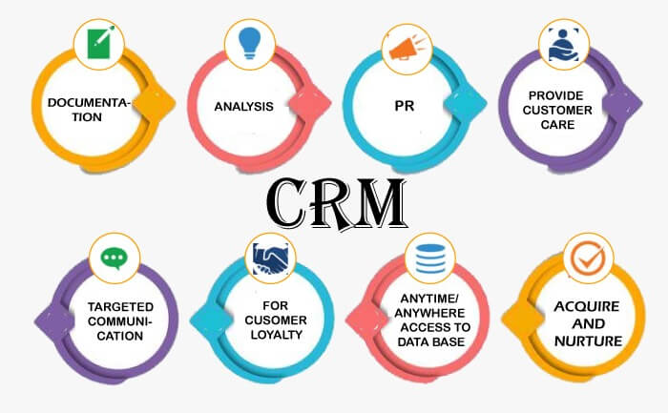
CRM [ Customer Relationship Management]
Technology for managing all the company’s relationships and interactions with customers and potential customers.

Slide 15
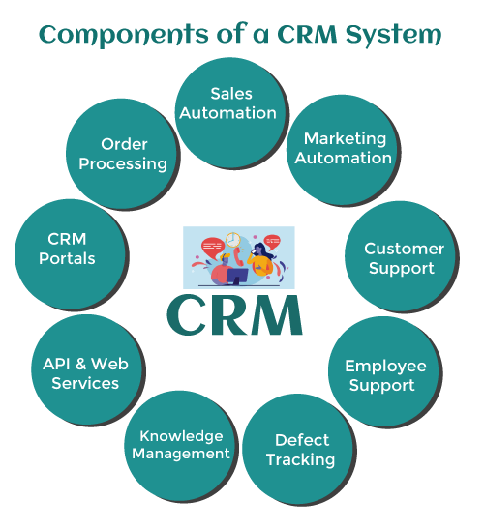
CRM [ Customer Relationship Management]

Slide 16
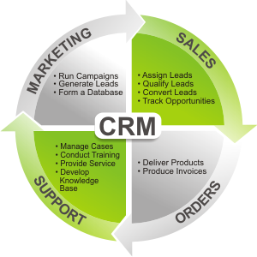
CRM STRATEGIES

Slide 17
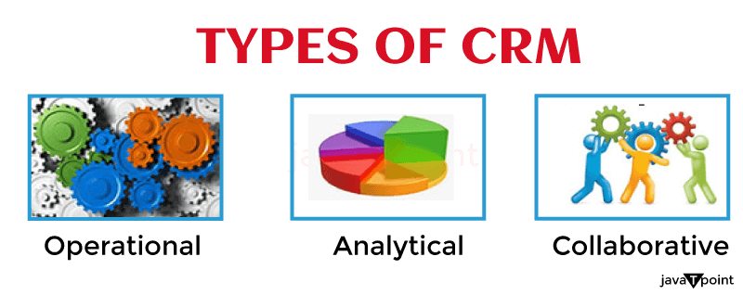
CRM [ Customer Relationship Management]

Slide 18
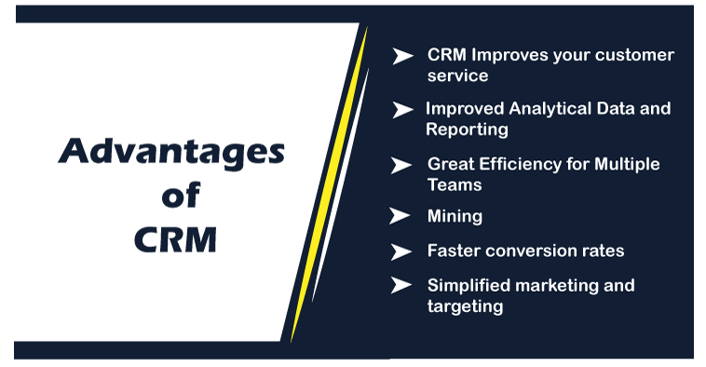
CRM [ Customer Relationship Management]

Slide 19
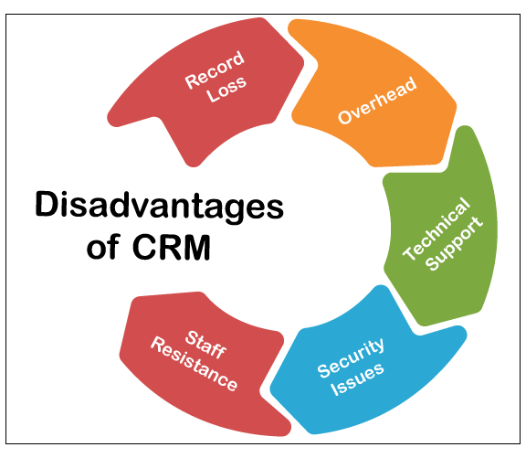
CRM [ Customer Relationship Management]

Slide 20
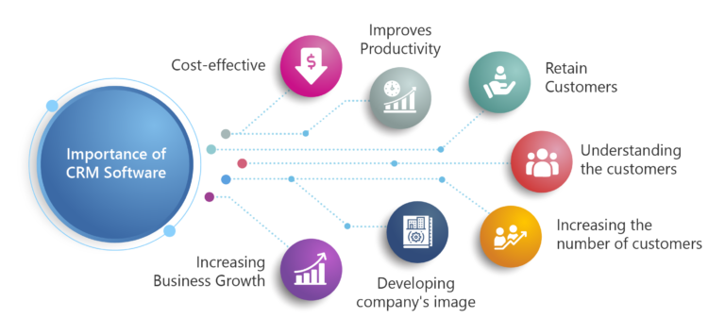
CRM [ Customer Relationship Management]

Slide 21
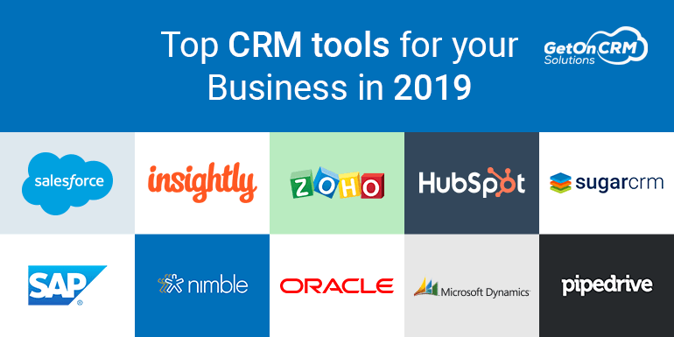
CRM [ Customer Relationship Management]

Slide 22
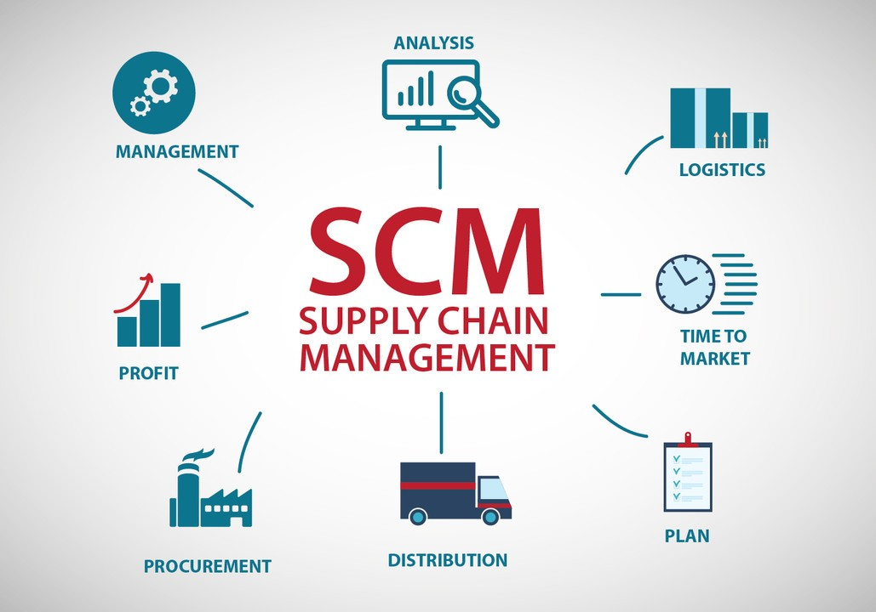
SCM [ Supply Chain Management]
It is the network of people, processes, and technologies that work together to get a product or service to the consumer.
The supply chain comprises a variety of operations, including the getting of raw materials, the production of items, their distribution, and their delivery to end-users.

Slide 23
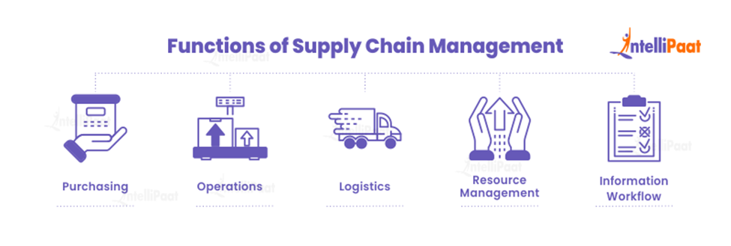
FUNCTION of SCM [ Supply Chain Management]

Slide 24
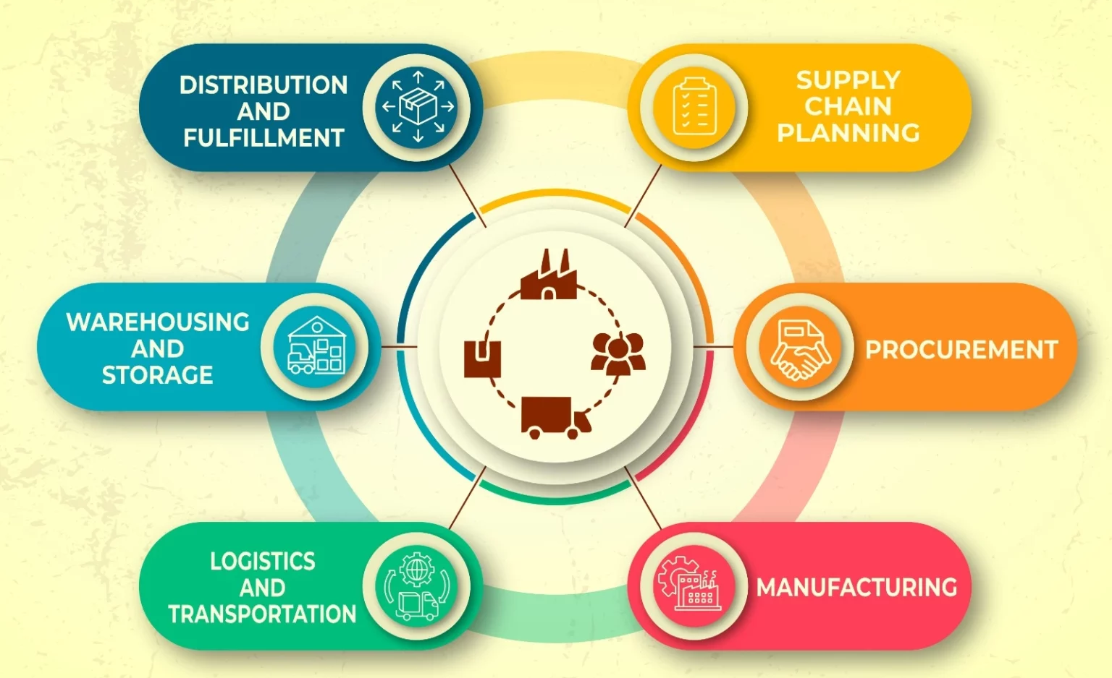
COMPONENTS of SCM [ Supply Chain Management]

Slide 25
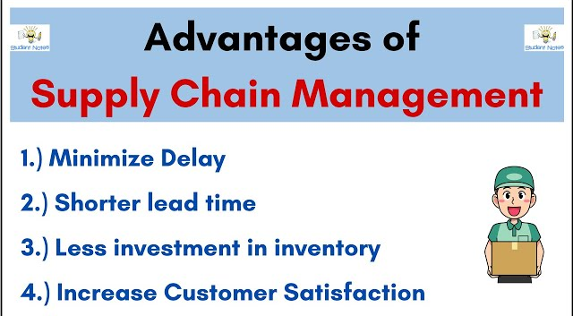

Slide 26
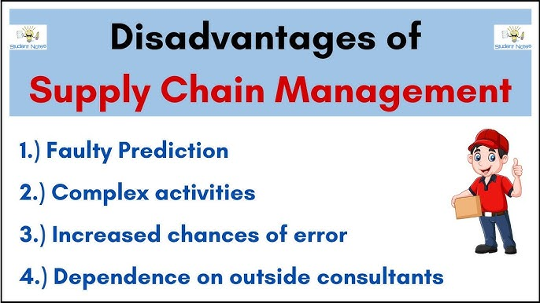

Slide 27
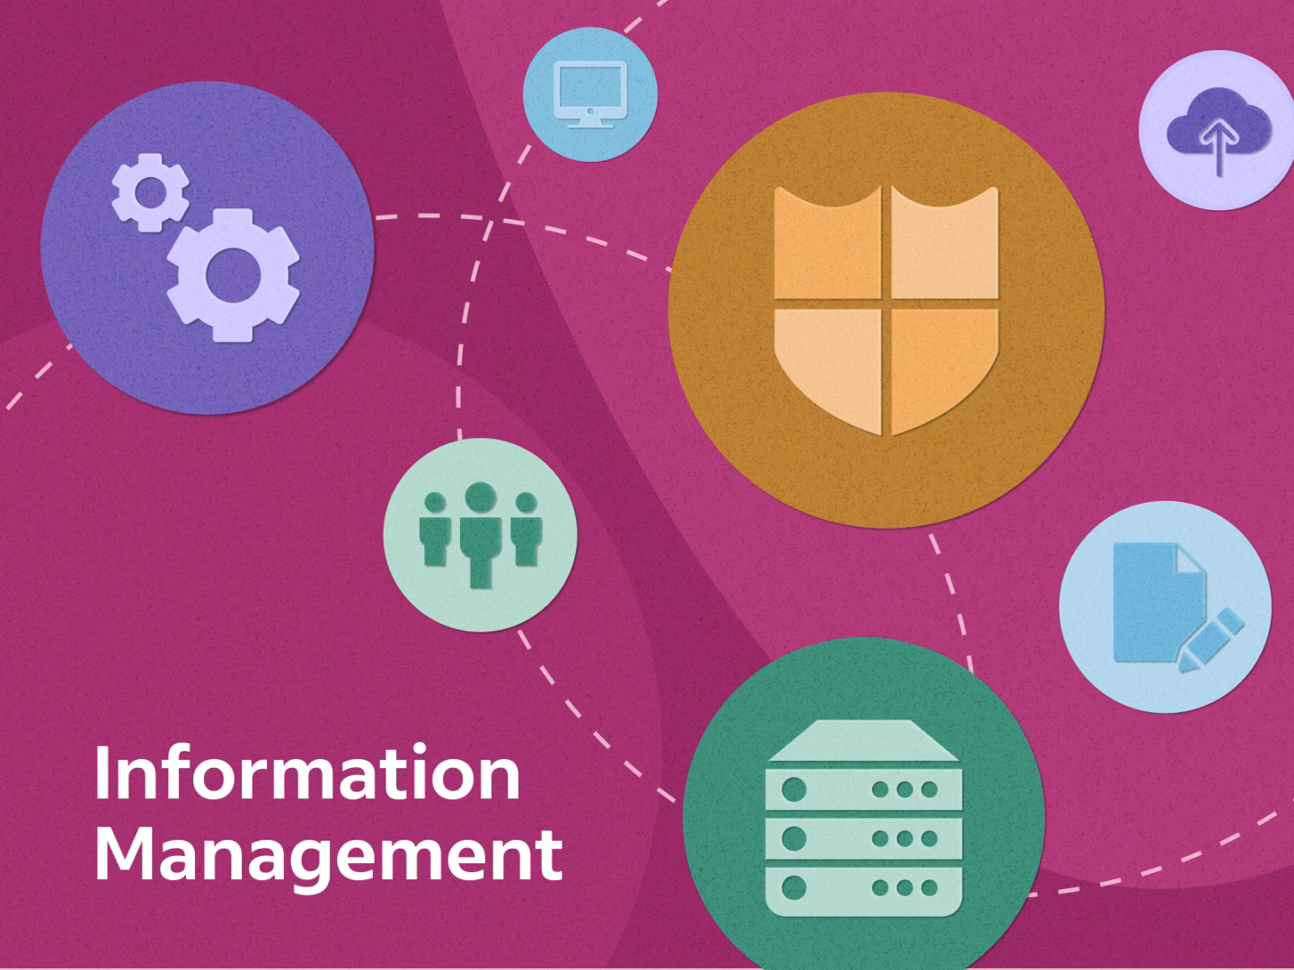
Information Management and Technology of Enterprise Software
It is the collection, storage, management and maintenance of data and other types of information
Managing the vital aspect of data that allows to make better decisions and achieve goals.

Slide 28

Technology of Enterprise Software
Top 10 Popular Technologies For Enterprise Software Development:
.NET Core
Artificial Intelligence (AI)
Internet of Things (IoT)
Information Security/DevSecOps (DevOps + Security)
Serverless Computing And Microservices
Predictive Analytics
Angular JS
Cloud Computing
Container Technology (Kubernetes, Docker)
DevOps

Slide 29
Services Provided by Enterprise Applications
Services provided by enterprise software are typically business-oriented tools, such as:
online shopping, and online processing,
interactive product catalogue,
automated billing systems,
security
Business Process Management,
enterprise content management,
IT Service Management,
customer relationship management,
enterprise resource planning,
project management,
collaboration,
human resource management,
manufacturing,
occupational health and safety,
enterprise application integration, and
enterprise forms automation.
payment▪

Slide 30
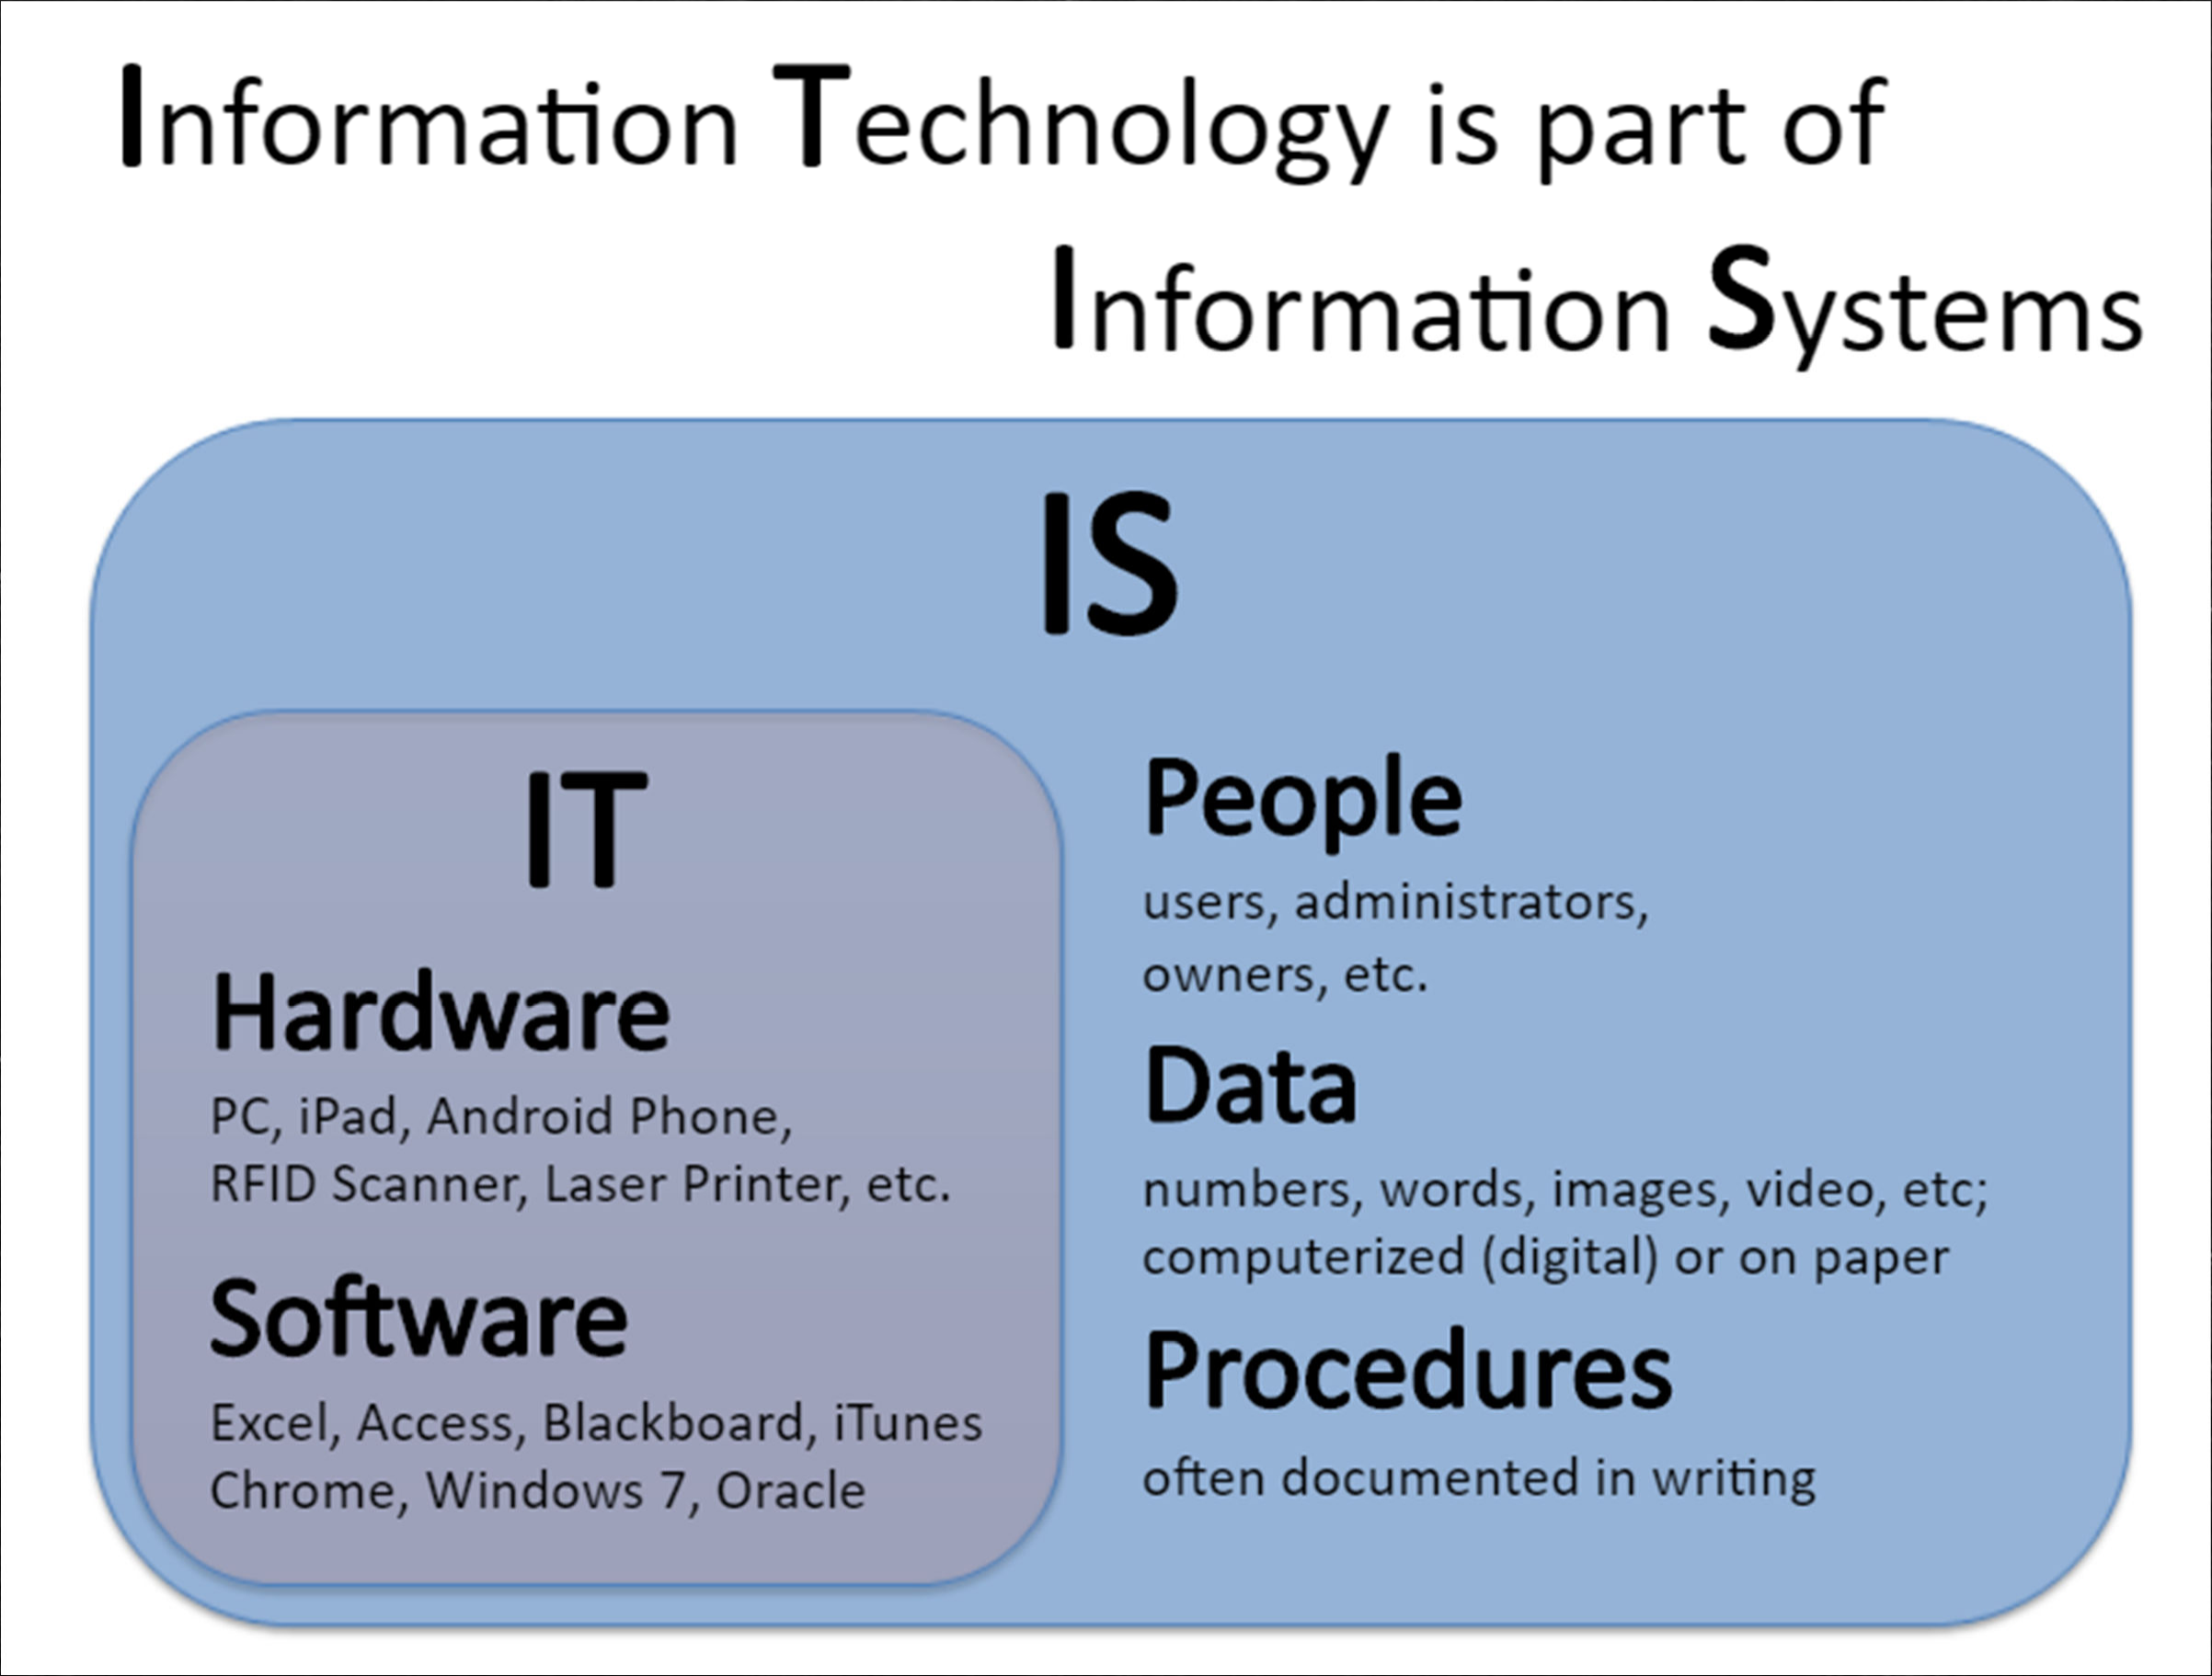
IT and IS

Slide 31
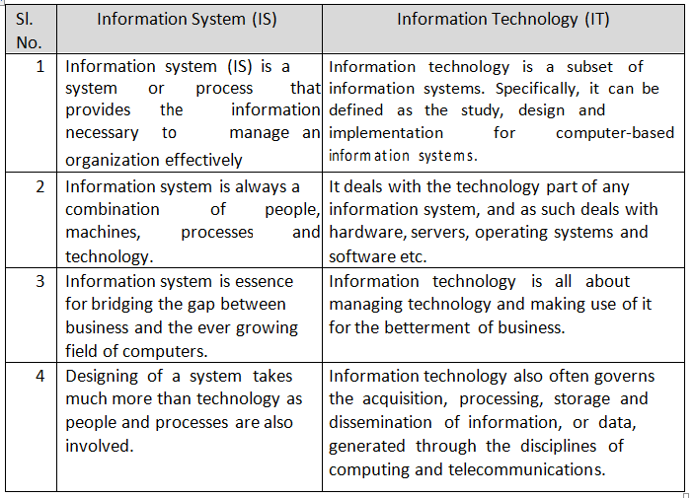
IS vs IT
payment▪

Slide 32
Role of IS in Enterprise Management
1. Automation of Manual Tasks
2.Hardware and Software Integration
3.Support of a Multi-Processing Environment
4.Provides Data for System Support
5.Results in improving productivity.
6.Communication
7.Inventory Management
8.Data Management
9.Management Information Systems
10.Customer Relationship Management

Slide 33
Enterprise Engineering
Enterprise engineering is defined as the body of knowledge, principles, and practices to design an enterprise.
An enterprise is a complex, socio-technical system that comprises interdependent resources of people, information, and technology that must interact with each other and their environment in support of a common mission.
Enterprise engineering is a sub discipline of systems engineering.
The discipline examines each aspect of the enterprise, including business processes, information flows, and organizational structure.
Enterprise engineering may focus on the design of the enterprise as a whole.

Slide 34
Two questions Enterprise Engineers always ask
What should the enterprise be?
How do we get there from here?

Slide 35
What do Enterprise Engineers do?
Identify and Integrate best and most successful ways to change an enterprise.
Two aspects-
Understand new mechanisms
New ways of organizing work
New corporate Architectures must be understood
Understand methods that can change an enterprise

Slide 36
Goal of the Enterprise Engineer
Identify and integrate the most valuable and successful ways to change an enterprise and
To take them into a professional discipline with a teachable methodology and measures of effectiveness.

Slide 37
Electronic Organism or Digital Organism
A digital organism is a self-replicating computer program that mutates and evolves.
used as a tool to study the dynamics evolution and to test or verify specific hypotheses or mathematical models of evolution.
The study of digital organisms is closely related to the area of artificial life.
refers to the electronic program for managing information system as well as data by using the electronic medium.

Slide 38
Need for Enterprise Integration
Integration of markets
Integration between several development and manufacturing sites
Integration between suppliers and manufacturers
Integration of design and manufacturing
Integration of multi-vendor hardware and software components

Slide 39
Basic principles for integration
Provide the vision, right information, resources, and responsibility
Empowered people
A comprehensive and effective communication networks
Democratization and dissemination of information
Freely shared information

Slide 40
Types of Integration
Loose Integration versus Full Integration
Horizontal Integration versus Vertical Integration
Intra-Enterprise Integration versus Inter-enterprise Integration
System Integration, Application Integration, and Business Integration

Slide 41
Loose Integration vs. Full Integration
Loose Integration - If two systems can merely exchange information with one another with no guarantee that they will interpret this information the same way.
Full integration - Two systems are fully integrated if and only if
The specificities of any one of these systems are only known to the system itself and not by the other one,
the two systems both contribute to a common task, and
the two systems share the same definition of each concept they exchange

Slide 42
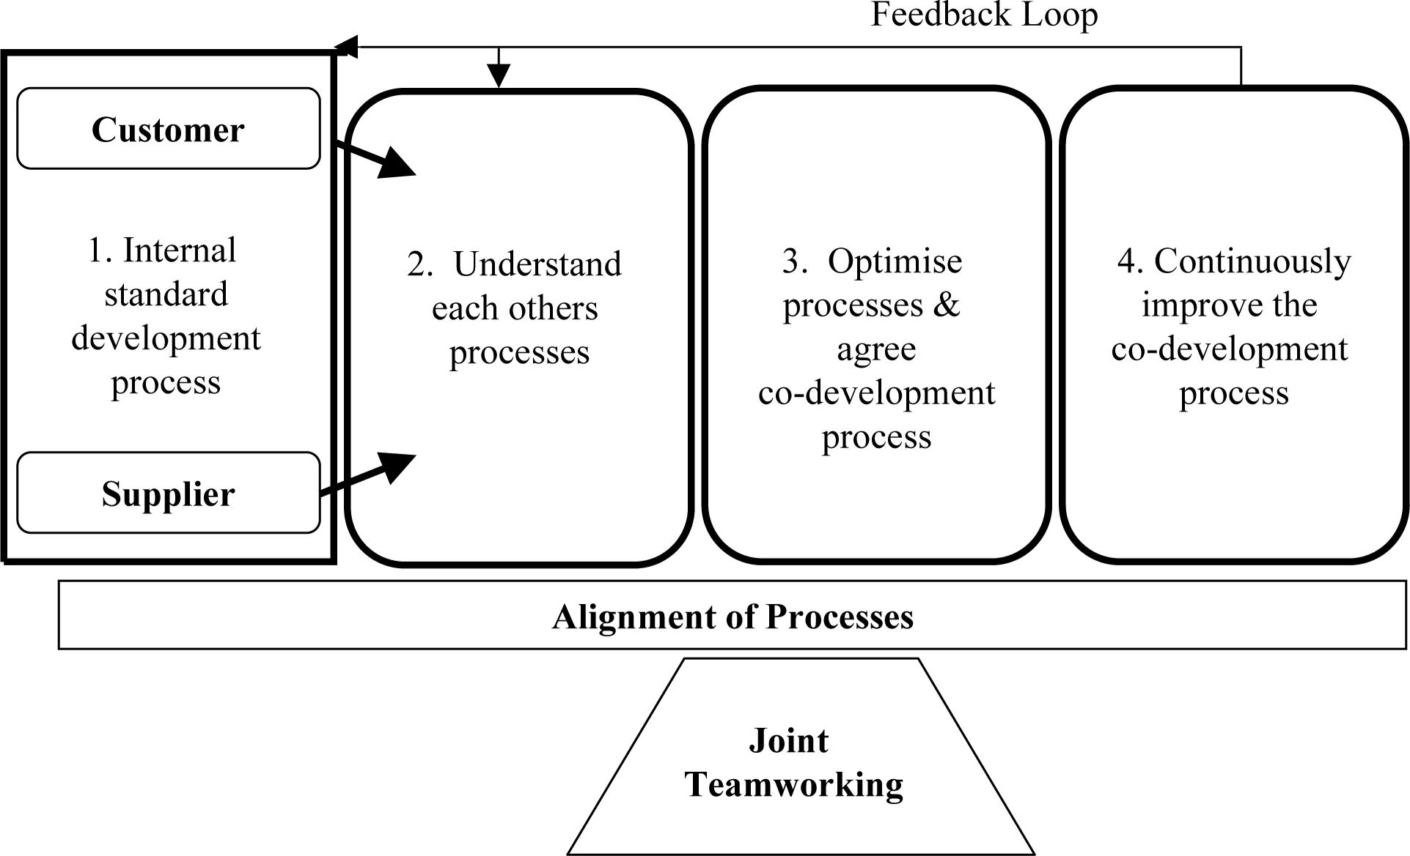
Process Alignment
Refers to the strategic coordination of different processes within an organization to ensure that they are all working towards common goals and objectives.
This involves harmonizing workflows, activities, and resources across departments and functions to optimize performance and enhance overall efficiency and effectiveness.
Project managers usually conduct a start-up meeting that is

Slide 43
Objective of Alignment Process
Strategic Alignment:
Operational Efficiency:
Consistency:
Customer Focus:
Flexibility and Adaptability:
Continuous Improvement:
Risk Management:

Slide 44
Framework to manage integrated change
Vision and Strategy:
Change Leadership:
Stakeholder Engagement:
Change Impact Assessment:
Change Planning and Execution:
Communication and Training:
Risk Management:
Measurement and Evaluation:
Continuous Improvement:
Sustainability and Embedding:
Change management is an organized, systematic application of the

Slide 45
Future Trends
Some example EMS by using the following future trends:
Artificial Intelligence
Neural Network
Expert System
Genetic Algorithm
Data Warehousing and Data Mining
Web Mining
Cloud Computing

Slide 46
END of UNIT 3

